Slide 1
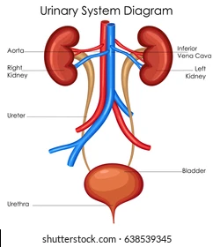
Fundamentals of Nursing (1st Stage)
Urinary Elimination
Lecture 4
By
Assistant. Lecturer. Khadija Mohammed Jassim
Fundamentals of Nursing Department
College of Nursing
University of Basrah
University of Basrah –College of Nursing – Fundamentals of Nursing Department

Slide 2
Anatomy And Physiology
Kidneys and Ureters
The kidneys are located on either side of the vertebral column behind the peritoneum, in the upper abdominal cavity. One of the more significant functions of the kidneys is to help maintain the composition and volume of body fluids. About once every 30 minutes, the body’s total blood volume passes through the kidneys for waste removal.
The kidneys filter and excrete blood constituents that are not needed and retain those
that are.
University of Basrah –College of Nursing– Fundamentals of Nursing Department
2

Slide 3
Despite varying kinds and amounts of food and fluids ingested, body fluids remain relatively stable if the kidneys are functioning properly. Urine, the waste product excreted by the kidneys, contains organic, inorganic, and liquid wastes.
The nephron is the basic structural and functional unit of the kidneys. There are about 1 million nephrons in each kidney.
Each nephron consists of a complicated system of arterioles, capillaries, and tubules. Nephrons remove the end products of metabolism, such as urea, creatinine, and uric acid from the blood plasma and form urine.
University of Basrah –College of Nursing– Fundamentals of Nursing Department
3

Slide 4
The nephrons maintain and regulate fluid balance through the mechanisms of selective reabsorption and secretion of water, electrolytes, and other substances.
Once formed, urine from the nephrons empties into the pelvis of each kidney. From each kidney, urine is transported by rhythmic peristalsis through the ureters to the urinary bladder.
The ureters enter the bladder obliquely. A fold of membrane in the bladder closes the entrance to the ureters so that urine is not forced up the ureters to the kidneys when pressure exists in the bladder.
University of Basrah –College of Nursing– Fundamentals of Nursing Department
4

Slide 5
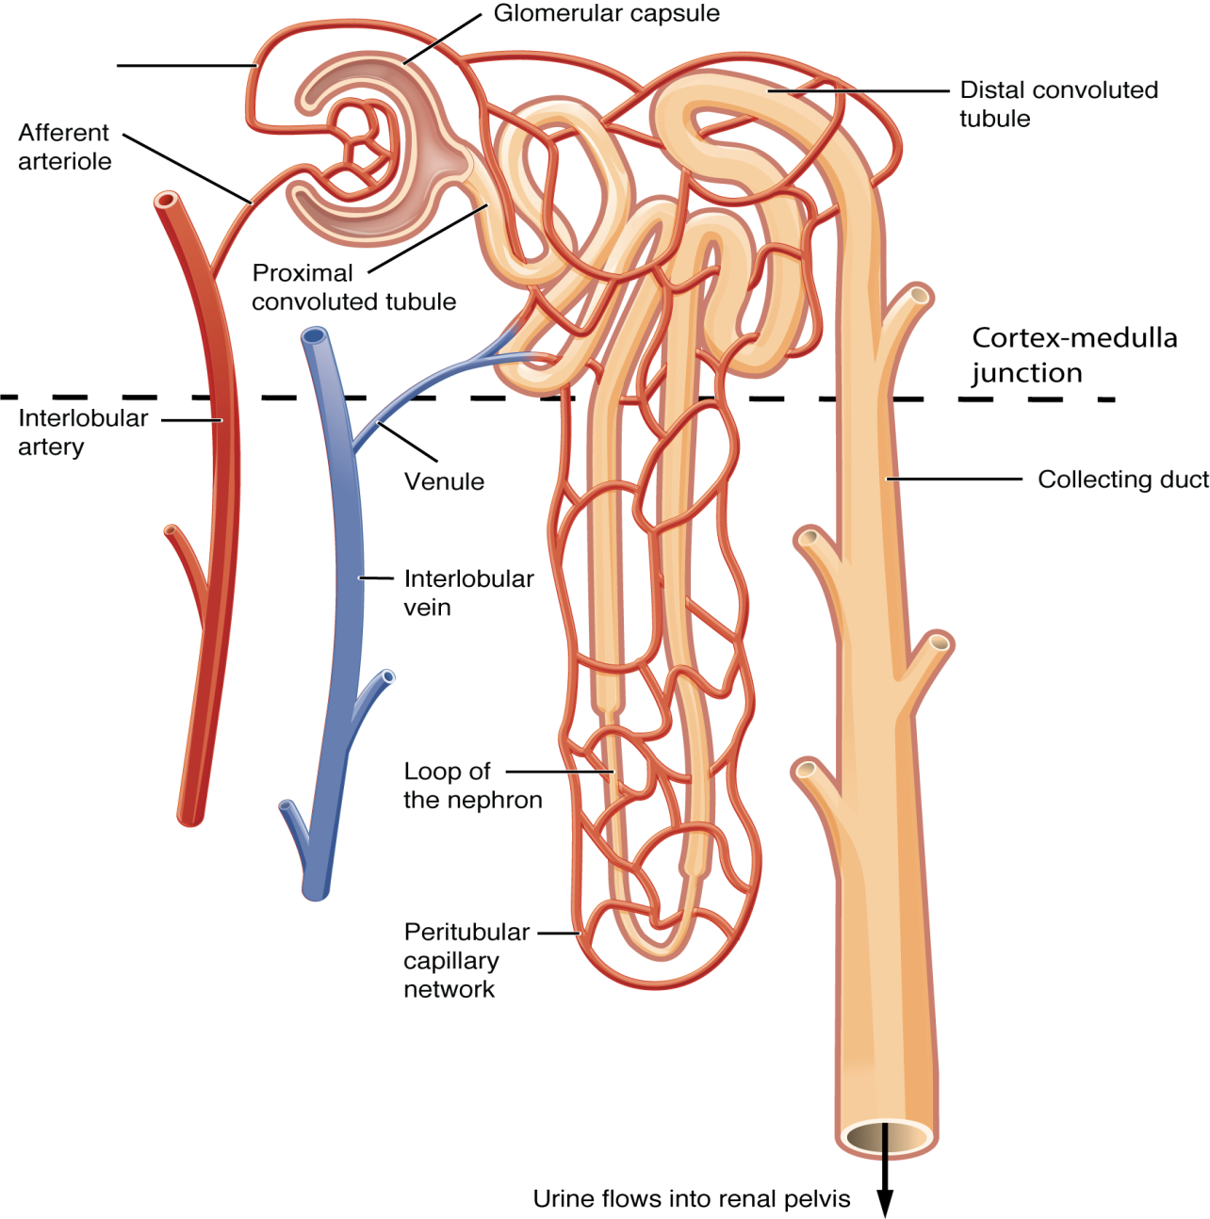
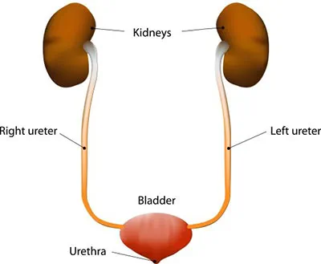
University of Basrah –College of Nursing– Fundamentals of Nursing Department
5

Slide 6
Bladder
The urinary bladder is a smooth muscle sac that serves as a temporary reservoir for urine. It is composed of three layers of muscle tissue: the inner longitudinal layer, the middle circular layer, and the outer longitudinal layer.
These three layers are called the detrusor muscle. At the base of the bladder,
the middle circular layer of muscle tissue forms the internal, or involuntary, sphincter, which guards the opening between the urinary bladder and the urethra. The urethra conveys urine from the bladder to the exterior of the body.
University of Basrah –College of Nursing– Fundamentals of Nursing Department
6

Slide 7
Urethra
The urethra’s function is to transport urine from the bladder to the exterior of the body. The anatomy of the urethra differs in males and females. The male urethra functions in the excretory system and the reproductive system. It is about
(13.7 to 16.2 cm) long and consists of three parts: the prostatic, the membranous, and the cavernous portions.
University of Basrah –College of Nursing– Fundamentals of Nursing Department
7

Slide 8
Characteristics Of Urine
Normal Findings | Characteristic
A freshly voided specimen is pale yellow, straw-colored, or amber, depending on its concentration. | Color
Normal urine smell is aromatic. As urine stands, it often develops an ammonia odor because of bacterial action. | Odor
Fresh urine should be clear or translucent; as urine stands and cools, it becomes cloudy. | Turbidity
The normal pH is about 6.0, with a range of 4.6 to 8. (Urine alkalinity or acidity may be promoted through diet to inhibit bacterial growth or urinary stone development or to facilitate the therapeutic activity of certain medications.). | pH
University of Basrah –College of Nursing– Fundamentals of Nursing Department
8

Slide 9
This is a measure of the concentration of dissolved solids in the urine. The normal range is 1.015 to 1.025. | Specific gravity
Organic constituents of urine include urea, uric acid, creatinine, hippuric acid, indican, urene pigments, and undetermined nitrogen. Inorganic constituents are ammonia, sodium, chloride, traces of iron, phosphorus, sulfur, potassium, and calcium. | Constituents
University of Basrah –College of Nursing– Fundamentals of Nursing Department
9

Slide 10
Terms Used To Describe Urinary Problems
Describe | Terms
24-hour urine output is less than 50 mL; synonyms are complete kidney shutdown or renal failure | Anuria
Painful or difficult urination | Dysuria
Increased incidence of voiding | Frequency
Presence of sugar in the urine | Glycosuria
Awakening at night to urinate | Nocturia
University of Basrah –College of Nursing– Fundamentals of Nursing Department
10

Slide 11
greatly diminished amount of urine voided in a given time; 24-hour urine output is less than 400 mL | Oliguria
Excessive output of urine (diuresis) | Polyuria
Protein in the urine; indication of kidney disease | Proteinuria
Pus in the urine; urine appears cloudy | Pyuria
Strong desire to void | Urgency
Involuntary loss of urine | Urinary incontinence
University of Basrah –College of Nursing– Fundamentals of Nursing Department
11

Slide 12
Nursing Process For
Urinary Elimination
Assessing
Collection of data about the patient’s voiding patterns, habits, and difficulties and a history of current or past urinary problems.
Physical examination of the bladder, if indicated, and urethral meatus; assessment of skin integrity and hydration; and examination of the urine.
University of Basrah –College of Nursing– Fundamentals of Nursing Department
12

Slide 13
Nursing Diagnoses
Impaired Urinary Elimination R/T multiple causality manifested by Urinary tract infection.
Functional Urinary Incontinence R/T weakened supporting pelvic structure manifested by Neuromuscular impairment.
Stress Urinary Incontinence R/T weak pelvic floor muscles manifested by Increase in intra-abdominal pressure .
Urinary Retention R/T be developed manifested by Blockage in urinary tract.
University of Basrah –College of Nursing– Fundamentals of Nursing Department
13

Slide 14
Planning
Nursing interventions should support planned patient outcomes.
The patient will:
Produce urine output about equal to fluid intake
Maintain fluid and electrolyte balance
Empty the bladder completely at regular intervals
Report ease of voiding
Maintain skin integrity
University of Basrah –College of Nursing– Fundamentals of Nursing Department
14

Slide 15
Implementing
Promoting Normal Urination
Maintaining Normal Voiding Habits
Promoting Fluid Intake
Strengthening Muscle Tone
University of Basrah –College of Nursing– Fundamentals of Nursing Department
15

Slide 16
University of Basrah –College of Nursing– Fundamentals of Nursing Department
21

